Slide 1
FINAL PRESENTATION
DATA PROGRAMMING
For: BDAT 1004
To: Mohammed Jibran
From: Ashwin 200497949

Slide 2



Link to the code used for analysis.
https://github.com/AshwinAshwin1/DP-Final-1004/blob/main/DP%20Final.ipynb

Slide 3


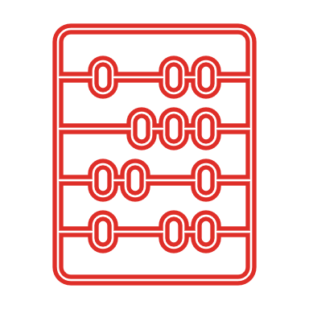
Amazon.com Inc Stocks Dataset
Dataset Source: MNC's stock dataset for the last 20 years
How much data is there ? 5,032 rows, records from 24-01-2001 to 22-01-2021 (20 years) of stocks data.
Categories/Dimensions
Date Company
Measures/Aggregates
Volume High Low Open Close

Slide 4


Amazon.com Inc Stocks Dataset
This dataset contains 20 years of Amazon.com Inc‘s stocks data.
It is collected by scraping Yahoo Finance using python.
What information can you get from the data?
Date of record.
The highest market price of the Amazon.com on the date.
The lowest recorded market price of the Amazon.com on the date.
The opening market price of the Amazon.com on the date.
The closing recorded price of the Amazon.com on the date.
Total traded volume of the Amazon.com on the date. (numeric/Quantitative).
The value of the dividend is deducted from the last closing sale price of the stock.
What is the highest market price of the equity in these 20 years?
What is the lowest market price of the equity in these 20 years?
Which year and day did largest volume of the equity traded in these years?

Slide 5
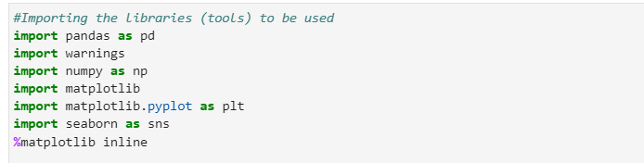
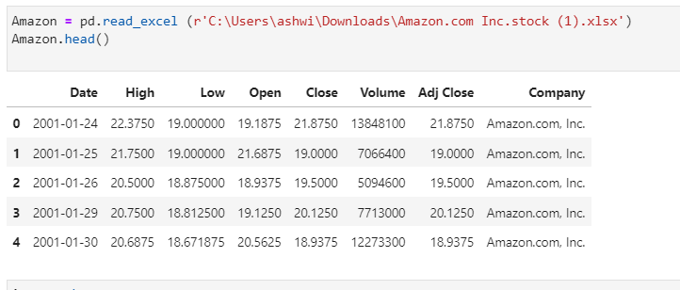
Data analysis of dataset using Python in Jupyter Lab

Slide 6
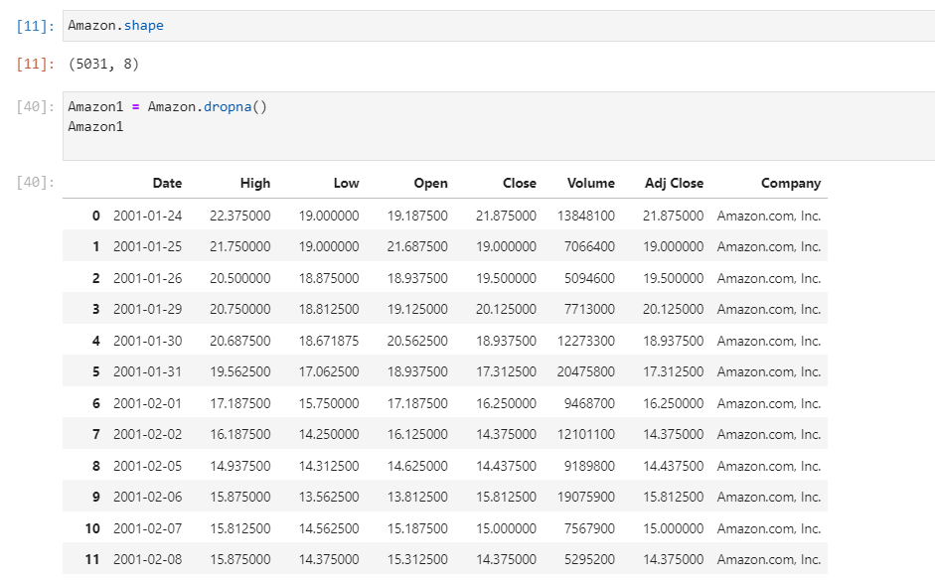
How many Rows and Columns? Clean?

Slide 7
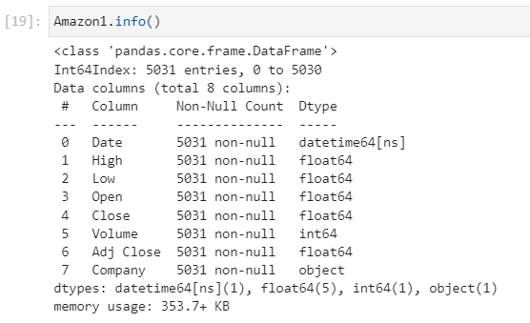
Dataset Info

Slide 8
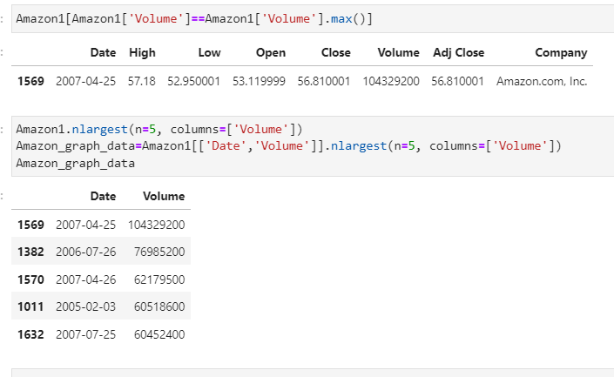
Which year and day did largest volume of the equity traded in these years?

Slide 9
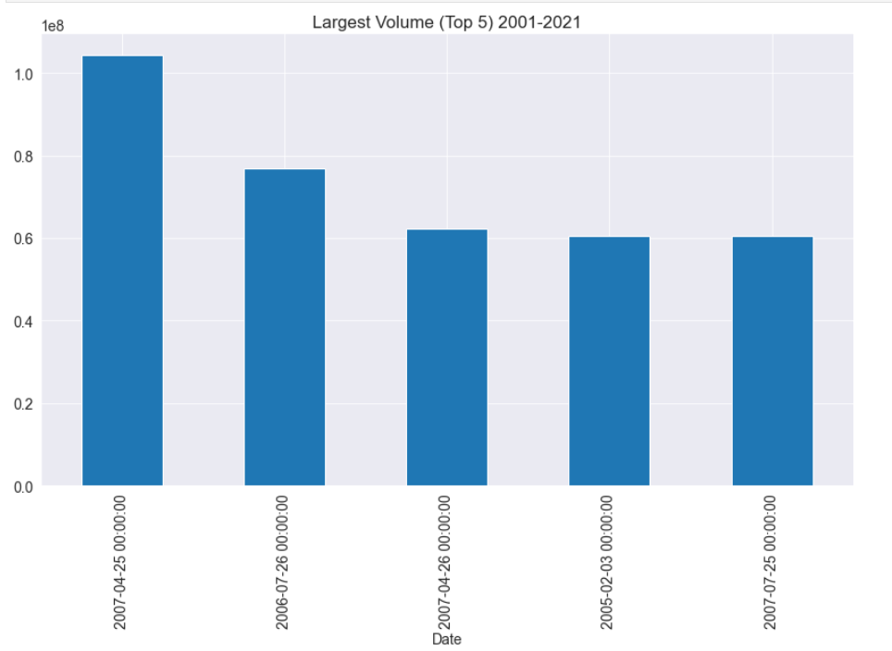

Slide 10
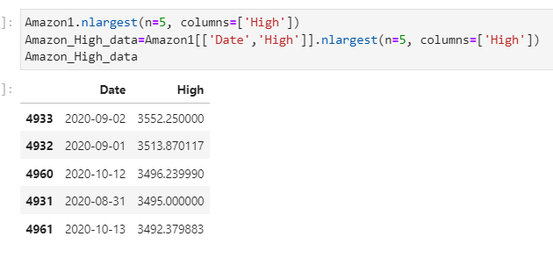
What is the highest market price of the equity in these 20 years?

Slide 11
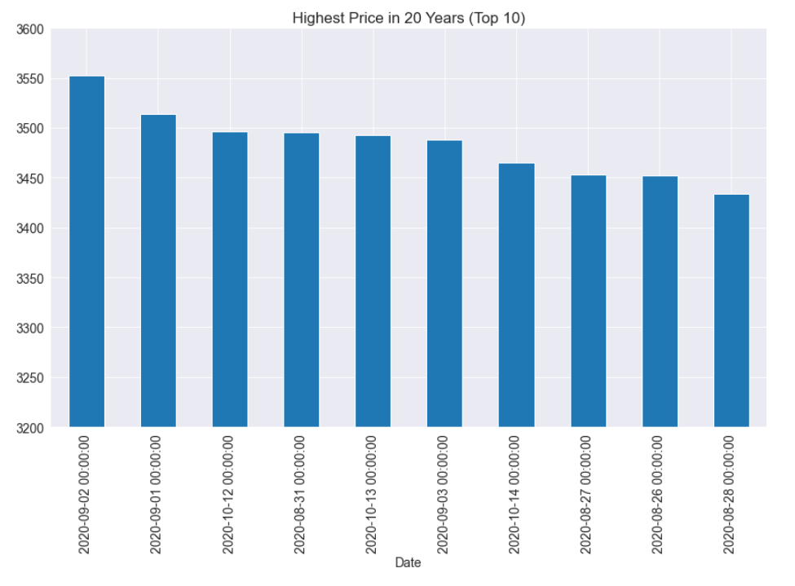

Slide 12
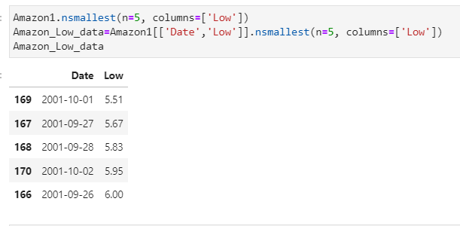
What is the lowest market price of the equity in these 20 years?

Slide 13
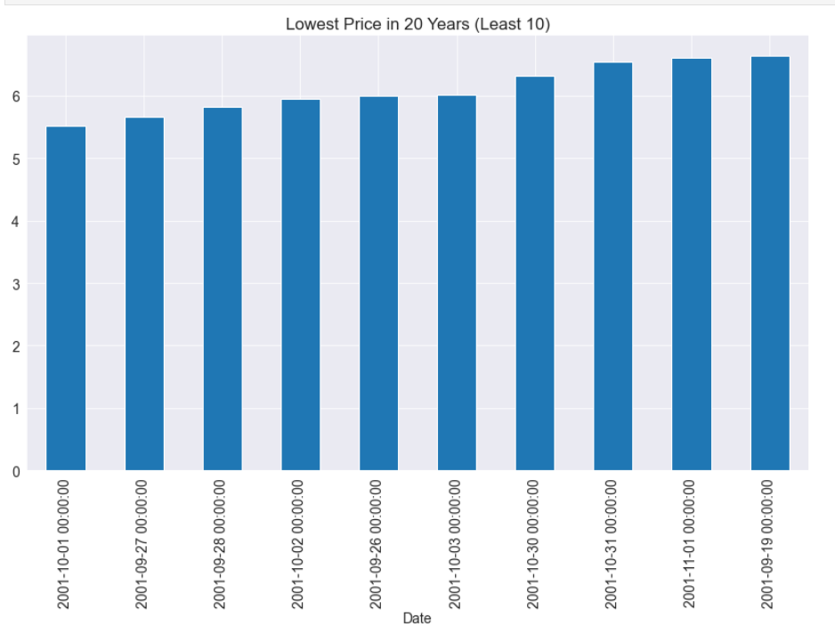

Slide 14

Conclusion and Why This Dataset?
2007 had highest volume of stocks exchanged
2001 had the least stock selling price.
2020 had highest stock selling price.
WHY ?
Further Analysis:
Investigate other Mnc’s and Compare with those data.
Analyse historical trend.
Use the data for Investment Advice

Slide 15
Thankyou….

